Slide 1

Performance Comparison of Insertion Sort and Selection Sort
CSCI 690, Spring 2025
Notes:
Introduce the project and context. Say this was done for your CSCI 681 final.

Slide 2
Objective & Abstract
Overview of Sorting Algorithms
Compare Selection Sort and Insertion Sort using empirical performance metrics over varied input data. Analyze trends with statistical rigor using t-tests and box plots
Scope: Runtime, Swaps, Comparisons, profiling, Statistics.
Notes:
Define goal clearly. Mention this is a full experiment with visualization, analysis, and metrics.

Slide 3
Methodology
Dataset: Arrays of size 100 (Random, sorted, reversed, duplicates)
Types: Integers and Floats.
Tools: Python, Time, Resource, cProfile, scipy.stats
Trials: 100 runs per configuration

Slide 4
Metrics Tracked
Wall Clock Time
CPU Time
Number of Swaps
Number of Comparisons
Profiling Summary
Notes:
Explain how each metric is captured and what it reveals.

Slide 5
Experimental Design
Optimization Flag Variants
Built-in sort Baseline for reference
Input Sensitivity (Type & Order)

Slide 6
Experimental Setup
Python implementation
Input Size: 5000 elements
Variants: Integer, Float
Tracked: Wall/CPU Time, Comparisons, Swaps
Mean Wall and CPU time for each sort
Comparison across random, sorted and reversed input.
Notes:
Explain setup logic. Talk about random vs fixed input. Clarify 100 runs ensure stability.

Slide 7
Statistical Methods
T-tests to compare runtime distributions
Visualized with box plots
p-value threshold: 0.05
Average swaps and comparisons over 100 trials
Differences in algorithmic operation costs
Notes:
Stress that this isn’t just timing — it's backed by statistics.

Slide 8
Statistical Analysis
Mean, median, Range of runtime and swaps.
Comparison across all data types and input orders.

Slide 9
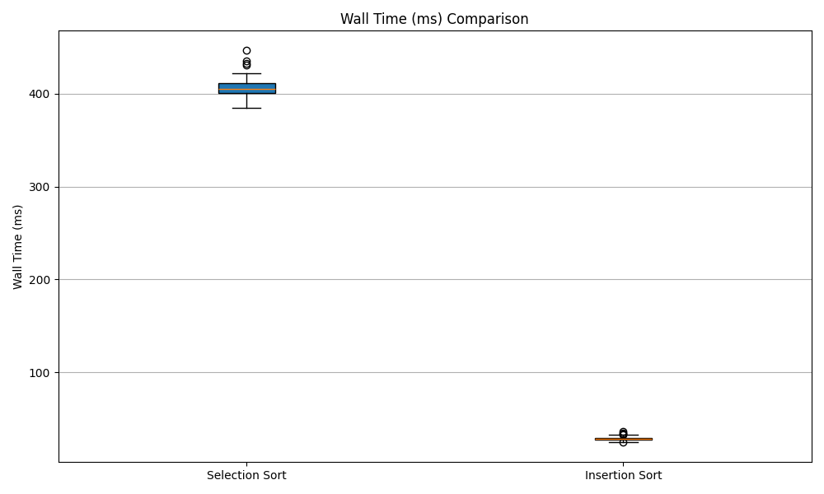
Box Plot: Wall Clock Time
Notes:
Insertion Sort has a clearly smaller range and median runtime.

Slide 10
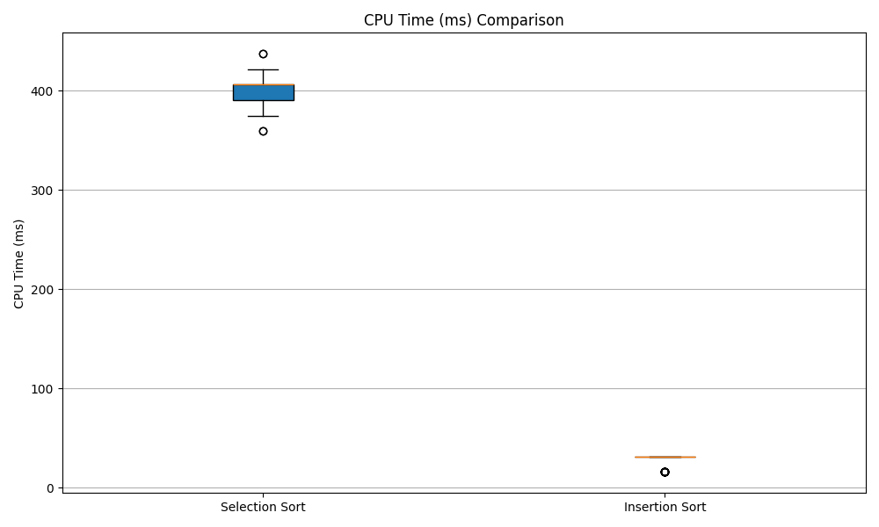
Box Plot: CPU Time
Notes:
Shows same result as wall time, confirms low system overhead.

Slide 11
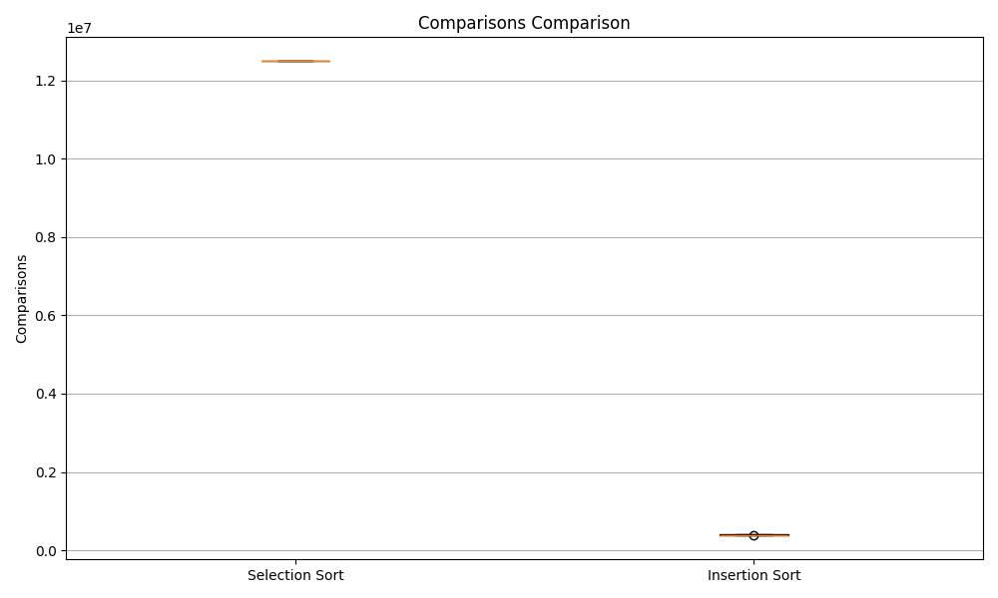
Box Plot: Comparisons
Notes:
Insertion Sort stops early on sorted segments. Fewer comparisons.

Slide 12
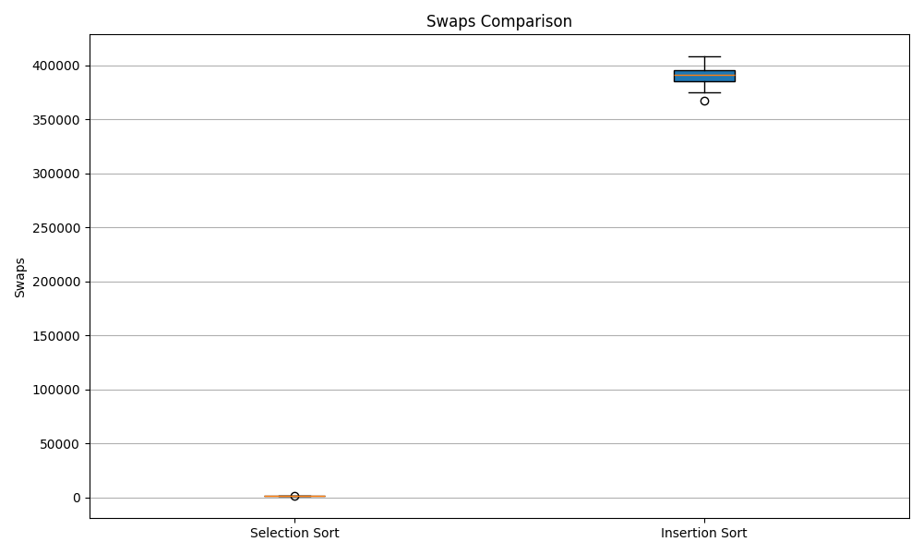
Box Plot: Swaps
Notes:
Insertion Sort swaps more frequently, but still performs better overall.

Slide 13
Results
Wall clock and CPU time T- tests
Statistical significance where P<0.05
cProfile analysis
Time spend in swap and comparison functions
Comparison with Python’s sorted()
Built-in sort significantly faster due to timesort
Results with and without optimization flags
Minimal differences observed in Python.
Execution time: Integers vs Floats
Float operations: consistently slower

Slide 14
Reflection
Learned to benchmark and visualize algorithm performance
Improved statistical literacy
Built tools from scratch for academic experiments
Notes:
Explain how this project helped you grow.

Slide 15
Conclusion & Future Work
Insertion Sort better for small and semi-sorted inputs
Selection Sort more predictable but slower.
Choose algorithm based on input nature.
Notes:
Close the loop on the story. Suggest what future analysis might reveal.

Slide 16
Limitations
Insertion Sort outperformed Selection Sort in time and comparisons
Swap count higher for Insertion Sort
Trends held true across all input types
Python interpreter overhead
Small input size
No concurrency tested
Future: Merge/Quick Sort, C/Java port, multithreading
Notes:
Mention t-test showed p < 0.001 in most cases. Significant difference confirmed.

Slide 17
References
Timsort documentation
Scipy.stats T- test
Algorithm complexity sources.

